Slide 1




Slide 2


OUR AGENDA
Goals
Project Requirements
Business Modules
Delivery in Numbers
Project Requirements
Tech Stack
Key Highlights
Data Sets
Data Anomalies
Data Dictionary
DB Design
Data Generation Techniques
Visualizations
Demo
Q n A

Slide 3

GOALS
To get the Anomalies data in the dataset
To clean-up the dataset
To generate the dataset for the Anomalies data
Provide a clean to the client

Slide 4
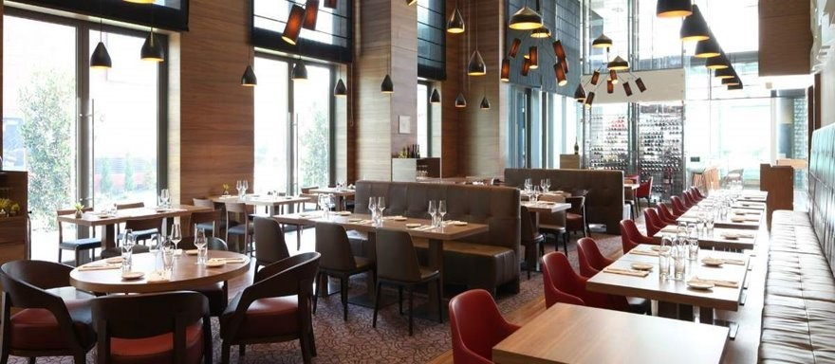
PROJECT INTRODUCTION
ROS – Restaurant One Solution
Restaurant One Solution is a rapidly growing SaaS company
Designed and developed to challenge existing technology available to hospitality industry.
Journey began in 2019 in UK based firm

Slide 5
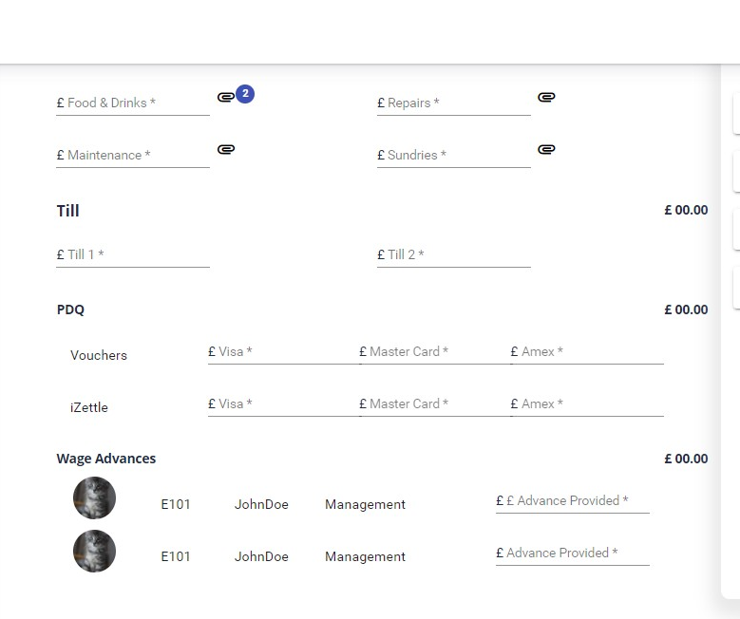
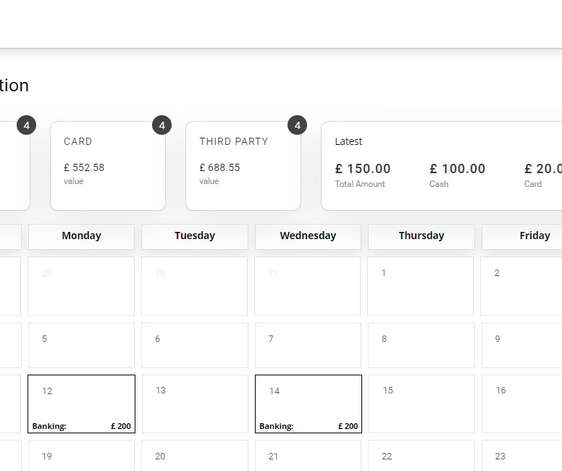
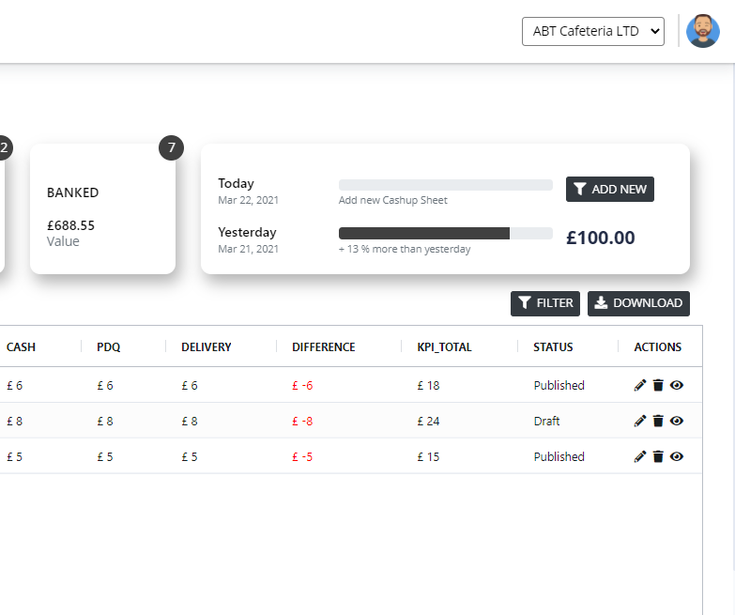
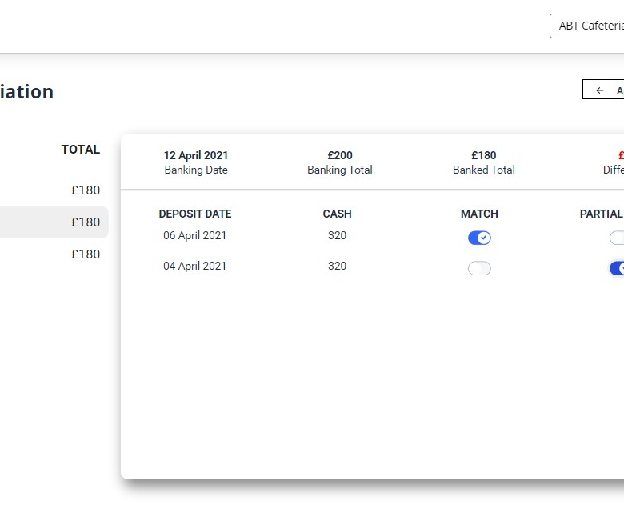
BUSINESS MODULES
ADMINISTRATION
Cash Up
Human Resource
Fig: APP VIEW

Slide 6
DELIVERY LANDSCAPE
DATA SET
DATA DICTIONARY
MASTER DATA
DATA ANOMALIES
DATA COLLECTION
DATA GENERATION
DATA CONNECTIONS
DATA INSIGHTS

Slide 7
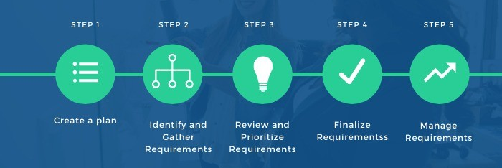
PROJECT REQUIREMENTS

Slide 8
DELIVERY IN NUMBERS
20
XX
XX
XX
20
137
DATA ENTITIES
DATA SETS
DATA FIELDS
XX
XX
XX
20
8
10
TABLES
VISUALIZATIONS
TECHNIQUES

Slide 9

TECHNOLOGY STACK

Slide 10
WORKFLOW
1.
REQ UNDERSTANDING
2.
DATA DICTIONARY
3.
DATA ANOMALIES
4.
DATA CLEANING
5.
DATA GENERATION
6.
DATA CONNECTIONS
7.
DATA VISUALIZATIONS
8.
RELEASE
9.
BUG FIXING
10.
REVIEW PRESENTATION

Slide 11
KEY HIGHLIGHTS – TECH VIEW
Pivot Chart
Pivot Tables
Cleaning up data
Random data generation

Slide 12
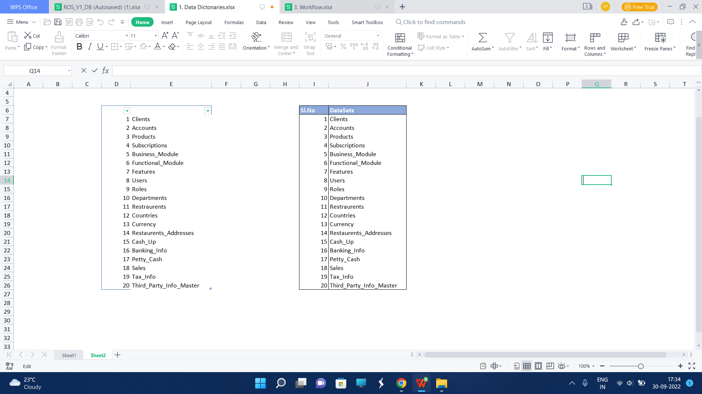
DATA SETS
XX
20
DATA SETS

Slide 13
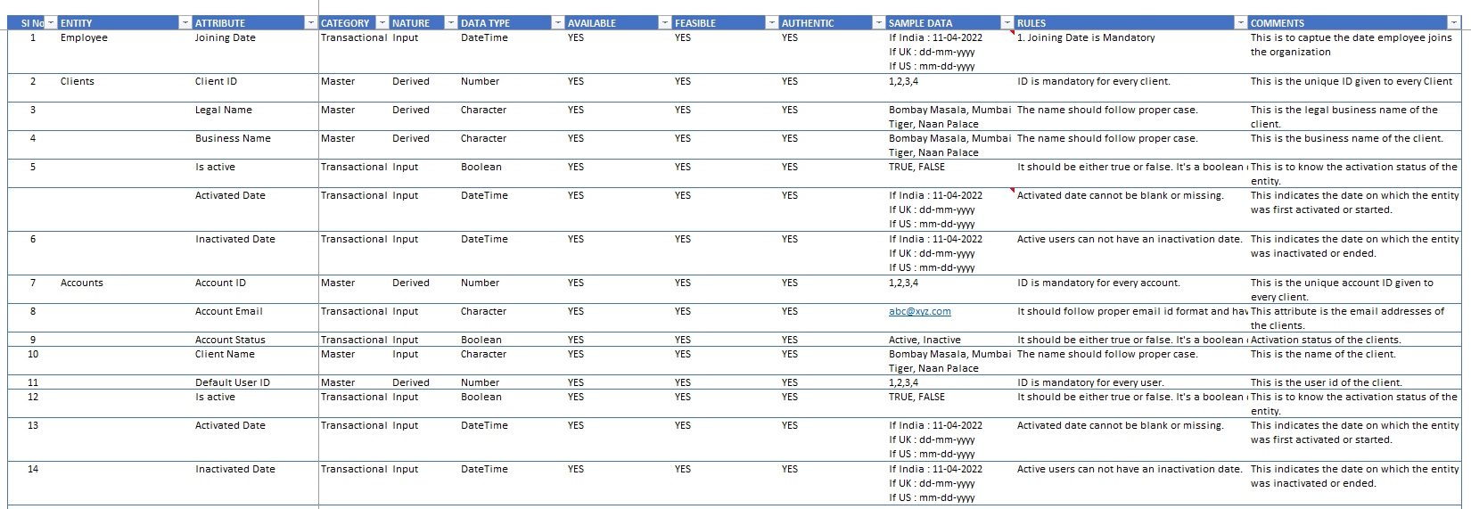
DATA DICTIONARY

Slide 14
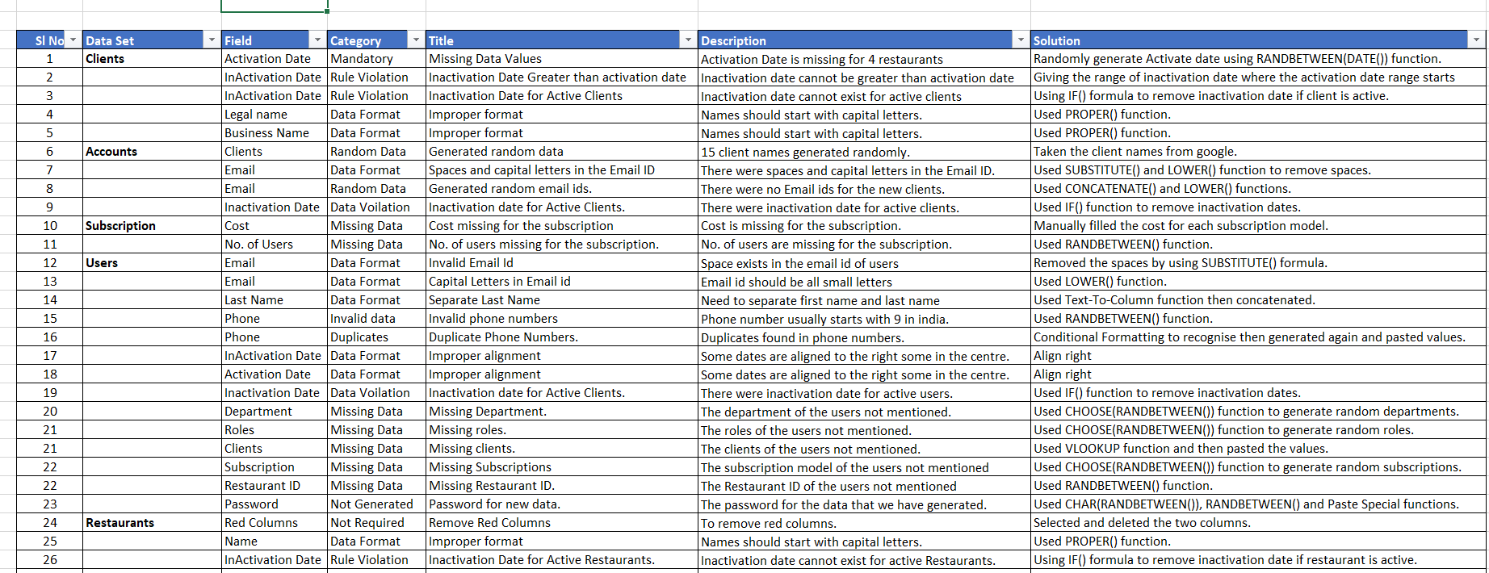
DATA ANOMALIES

Slide 15
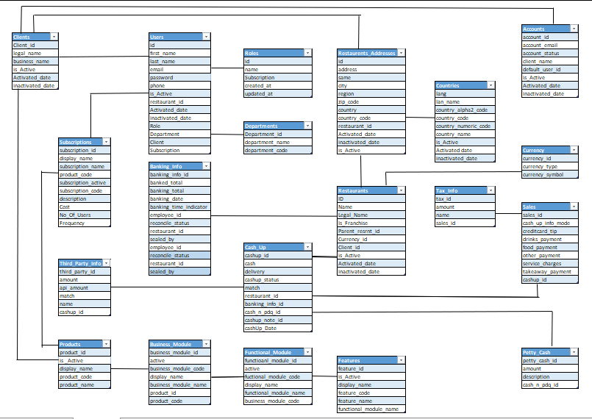
DB DESIGN

Slide 16


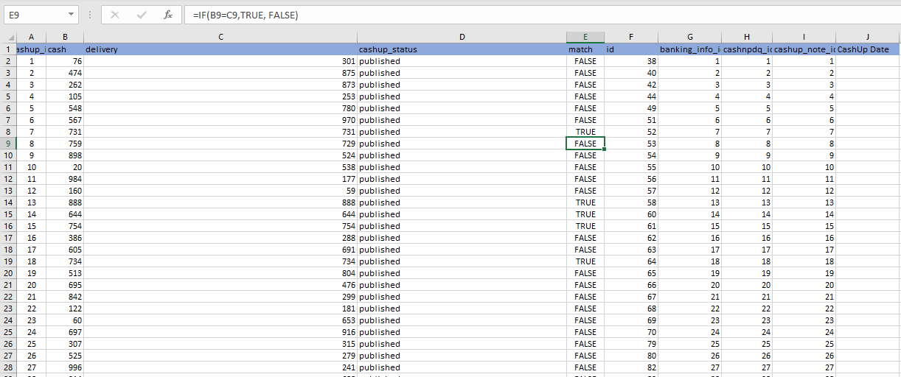
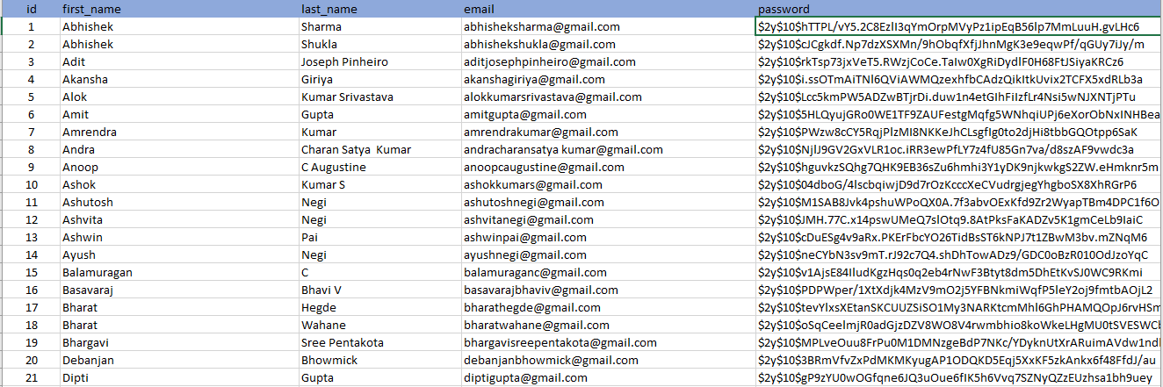
DATA GENERATION
XX
30
TECHNIQUES
RANDBETWEEN
FIND & REPLACE
FILL Technique
Git repo
RESTAURANTS
XX
750
USERS
XX
50000
CASHUPS
XX
120
BANKING

Slide 17


ANALYTICS FOR ROS
XX
XX
20
1
ENTITIES
REPORTS
8
VISUALIZATIONS

Slide 18
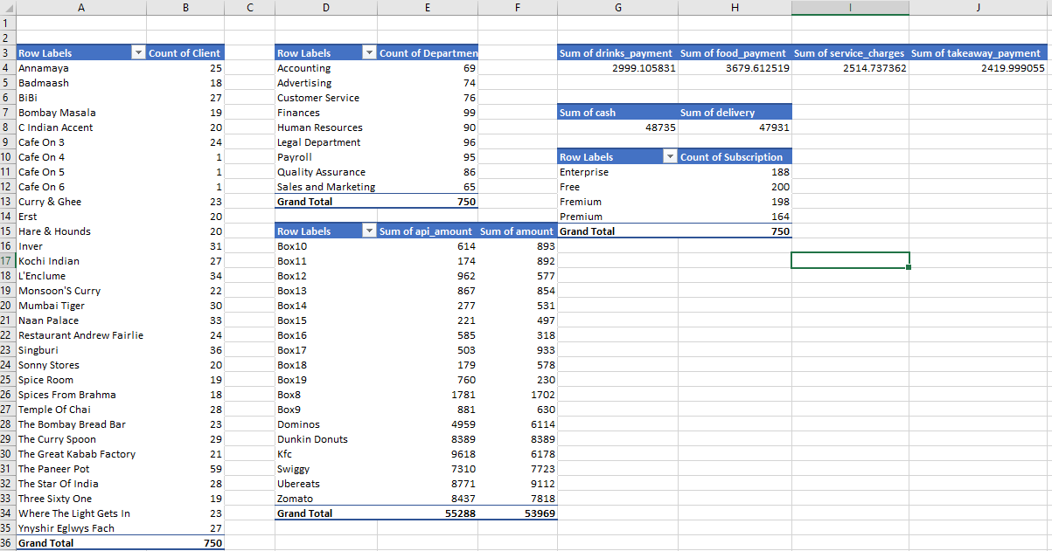
PIVOT TABLES

Slide 19

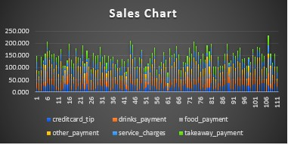
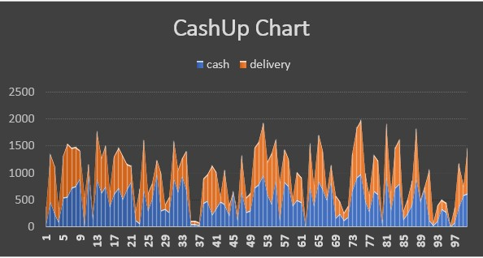
VISUALIZATION

Slide 20
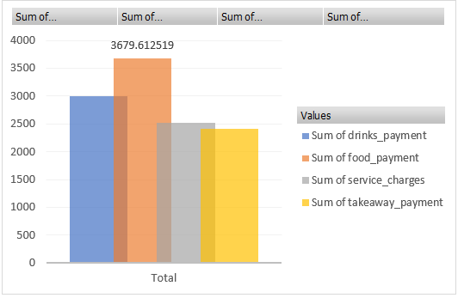
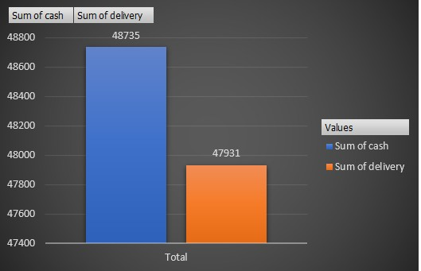

Slide 21
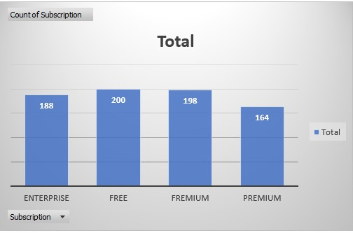
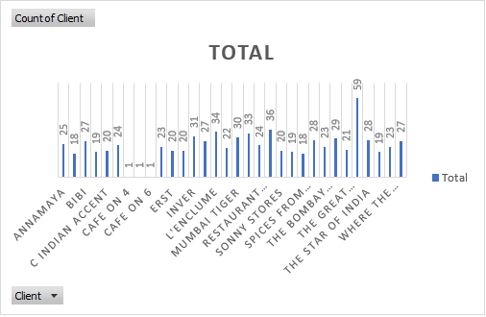

Slide 22
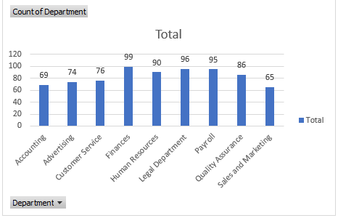
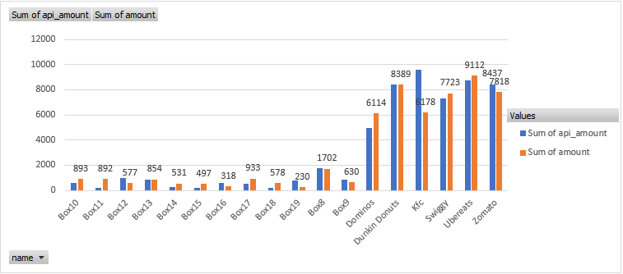

Slide 23

Thank You
© Pratian Technologies (India) Pvt. Ltd, 2020

